Slide 1
Machine Failure Analysis: Exploratory Data Analysis

Slide 2
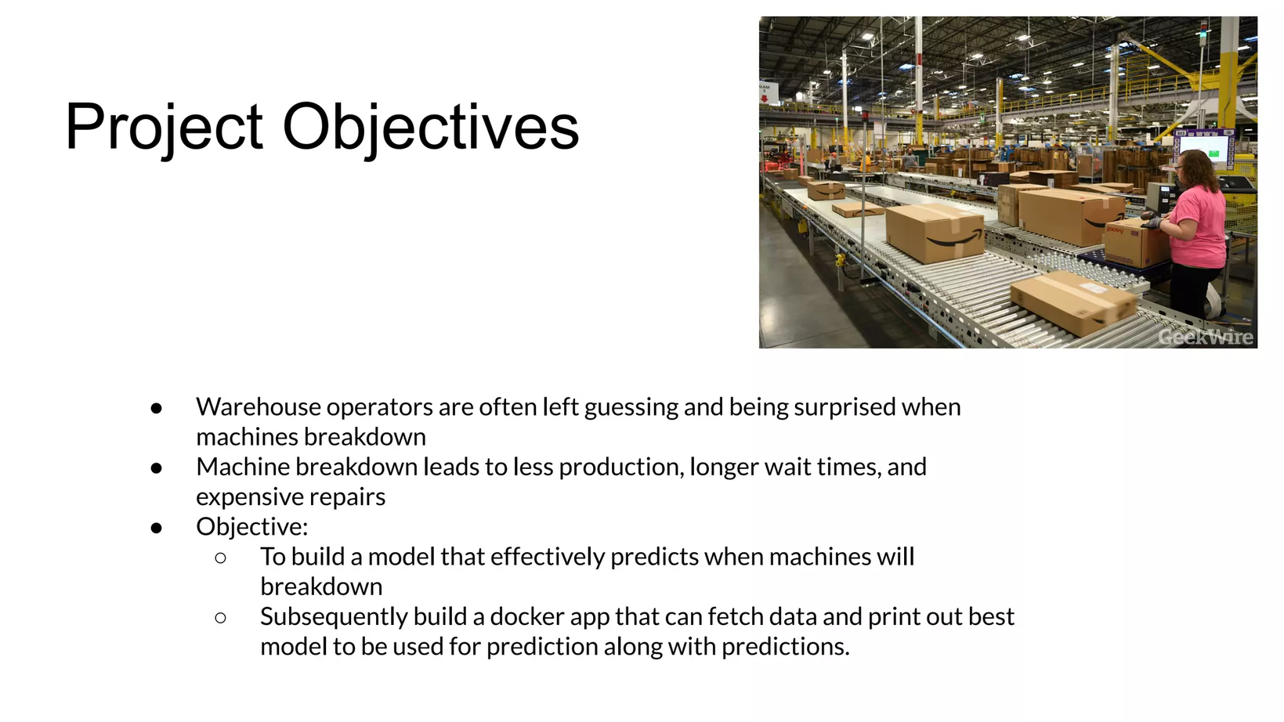
Problem Statment
The aim of this study is to develop and compare machine learning models for predicting machine failures in an industrial setting using the AI4I 2020 Predictive Maintenance (Machine Failures) Dataset. The goal is to identify the most effective model for predictive maintenance strategies.

Slide 3
Data Overview
Source: Kaggle (Playground Series)
Training Data: 136,429 records, 14 features
Testing Data: 90,954 records, 13 features
Data Types: Categorical, Numerical, Floating

Slide 4
Key Dataset Features
Air temperature
Process temperature
Rotational speed
Torque
Tool wear
Machine failure (target variable)
Specific failure types (TWF, HDF, PWF, OSF, RNF)

Slide 5
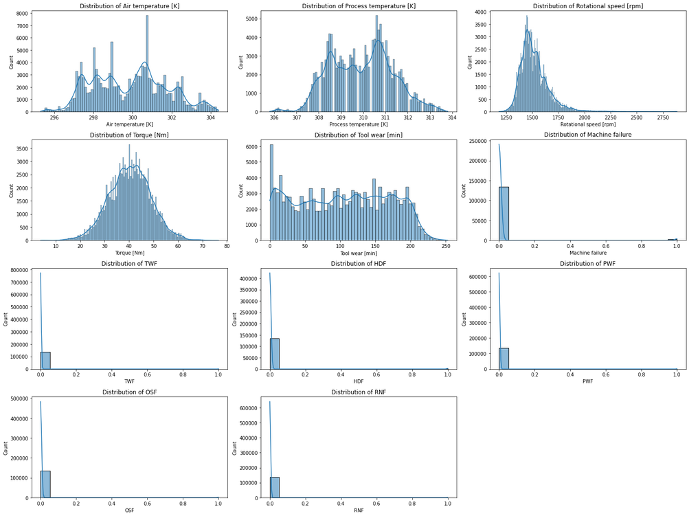
Exploratory Data Analysis
Air temperature: Fluctuates around 300K
Process temperature: Shows upward trend over time
Rotational speed: Two prominent peaks (1750 rpm and 2500 rpm)
Torque: Fluctuates around 30 Nm

Slide 6
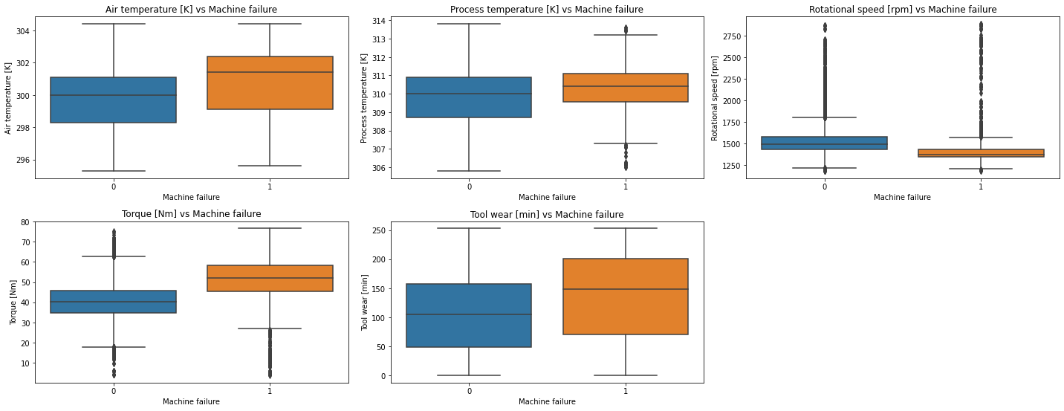
Bivariate Analysis
Torque and tool wear show signs of overstrain
Overstrain associated with low variance and lower rotational speeds
High torque at lower speeds indicates potential issues

Slide 7
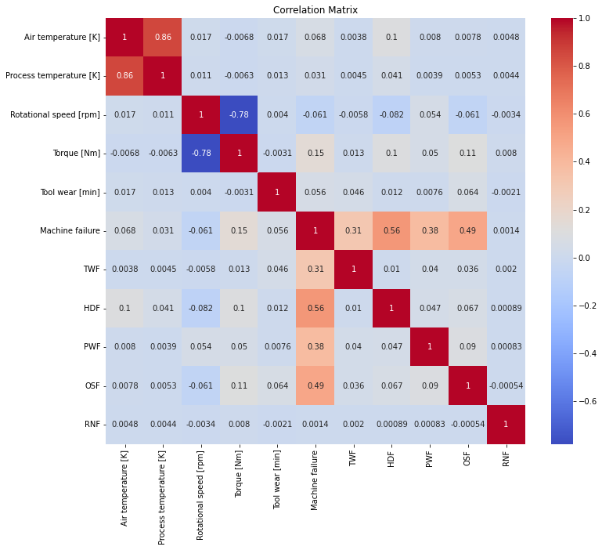
Multivariate Analysis - Correlations
Strong positive correlations: Machine failure with HDF, OSF, PWF
Moderate positive correlation: Machine failure with TWF
Weak positive correlations: Machine failure with Torque, Air temperature, Tool wear, Process temperature
Weak negative correlation: Machine failure with Rotational speed

Slide 8
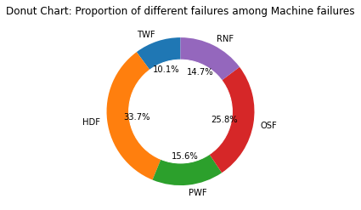
Failure Type Distribution
There are a total of 208 tool wear failures.
There are a total of 701 heat dissipation failures.
There are a total of 320 power failures.
There are a total of 533 overstrain failures.
There are a total of 306 random failures.

Slide 9
Conclusion
Our analysis of the dataset reveals critical insights into machine operations and failures. Higher air and process temperatures, as well as increased torque and tool wear, are associated with machine failures across different machine types. Conversely, lower rotational speeds are linked to higher failure rates. These findings highlight key factors influencing machine reliability and can guide targeted maintenance and operational strategies to mitigate failures.

